Slide 1

מבני נתונים
תרגול 7 – ערמה
צבי מינץ – zvimints@gmail.com

Slide 2
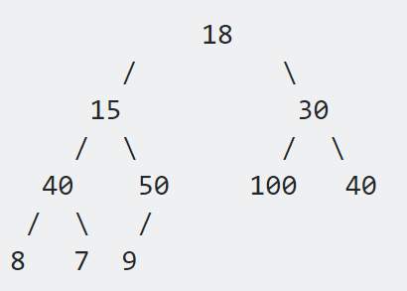
תרגולים קודמים
עץ בינארי (Binary Tree) – עץ אשר לכל קודקוד יש לכל היותר 2 בנים
עץ בינארי שלם (Complete Binary Tree)
עץ בינארי הוא עץ בינארי שלם אם כל הרמות מלאים בעלים חוץ מהרמה האחרונה
כאשר כל העלים ברמה האחרונה הם מצד שמאל ככל היותר
Notes:
So your next question probably is ‘what is a heap’?
I usually make up my own definitions, but I really like this one from Wiki.
Read slide.
What this means is that the value of parent node is always greater than or equal to the
value of the child node for all nodes or that the value of parent node is always less than
or equal to the value of the child node for all nodes. This means there are two types
of heaps max heaps and min heaps.
The following are binary heaps. Binary because every node has exactly two children, and
the children you cannot see are null values I haven’t drawn. On the left is a max heap
because for all nodes except the root the parent node has a value greater than or equal to its children.
Similarly on the right is min heap.
So why are we interested in heaps? Well heaps form the canonical underlying data structure for priority queues, so much so that priority queues are sometimes called heaps although this isn’t technically correct since a priority queue is an ADT meaning it can be implemented with other data structures also.

Slide 3


Binary Heap
8
0
7
6
2
3
3
2
5
4
5
6
4
Max Heap
Min Heap
כל האיברים בעץ ניתנים להשוואה (Comparable) ושורש העץ הוא תמיד המינמלי | כל האיברים בעץ ניתנים להשוואה (Comparable) ושורש העץ הוא תמיד המקסימלי
הערך של כל קודקוד קטן או שווה מהערך של בניו - heap property | הערך של כל קודקוד גדול או שווה מהערך של בניו - heap property
עץ בינארי כמעט שלם | עץ בינארי כמעט שלם
Notes:
So your next question probably is ‘what is a heap’?
I usually make up my own definitions, but I really like this one from Wiki.
Read slide.
What this means is that the value of parent node is always greater than or equal to the
value of the child node for all nodes or that the value of parent node is always less than
or equal to the value of the child node for all nodes. This means there are two types
of heaps max heaps and min heaps.
The following are binary heaps. Binary because every node has exactly two children, and
the children you cannot see are null values I haven’t drawn. On the left is a max heap
because for all nodes except the root the parent node has a value greater than or equal to its children.
Similarly on the right is min heap.
So why are we interested in heaps? Well heaps form the canonical underlying data structure for priority queues, so much so that priority queues are sometimes called heaps although this isn’t technically correct since a priority queue is an ADT meaning it can be implemented with other data structures also.

Slide 4
Binary Heap Representation
value
9 | 8 | 7 | 6 | 5 | 1 | 2 | 2 | 2 | 3 | 4 | 0 | 1 | 2 | 1
1 | 2 | 3 | 4 | 5 | 6 | 7 | 8 | 9 | 10 | 11 | 12 | 13 | 14 | 15
index
1
9
2
Index
Tree
3
8
7
4
5
6
7
6
5
1
2
8
9
10
11
12
13
14
15
2
2
3
4
0
1
2
1
Notes:
One last thing before we get into how to add values to our binary heap, I promise.
We need to understand how do we represent and construct one of these binary heaps.
Well, one of the most popular ways to represent a heap is by using an array because
of the complete tree property we talked about. This is however not the only way to
represent a heap we could also use objects and pointers and recursively add and
remove nodes as needed, but right now we’re going to look at the array based construction.
On the left is the index tree to help you visualize the position of each node in the array, and
on the right is the actual tree. Remark that as you read elements in the array from left to right
it’s as though you’re pacing through the heap one layer at a time from left to right.

Slide 5
Binary Heap Representation
value
9 | 8 | 7 | 6 | 5 | 1 | 2 | 2 | 2 | 3 | 4 | 0 | 1 | 2 | 1
1 | 2 | 3 | 4 | 5 | 6 | 7 | 8 | 9 | 10 | 11 | 12 | 13 | 14 | 15
index
1
9
2
Index
Tree
3
8
7
4
5
6
7
6
5
1
2
8
9
10
11
12
13
14
15
2
2
3
4
0
1
2
1
Notes:
One last thing before we get into how to add values to our binary heap, I promise.
We need to understand how do we represent and construct one of these binary heaps.
Well, one of the most popular ways to represent a heap is by using an array because
of the complete tree property we talked about. This is however not the only way to
represent a heap we could also use objects and pointers and recursively add and
remove nodes as needed, but right now we’re going to look at the array based construction.
On the left is the index tree to help you visualize the position of each node in the array, and
on the right is the actual tree. Remark that as you read elements in the array from left to right
it’s as though you’re pacing through the heap one layer at a time from left to right.

Slide 6
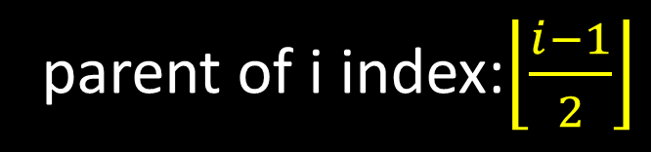
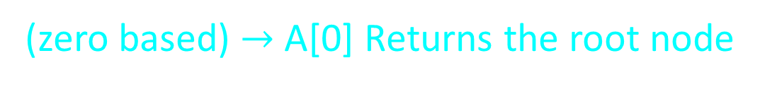
Binary Heap Representation
value
9 | 8 | 7 | 6 | 5 | 1 | 2 | 2 | 2 | 3 | 4 | 0 | 1 | 2 | 1
0 | 1 | 2 | 3 | 4 | 5 | 6 | 7 | 8 | 9 | 10 | 11 | 12 | 13 | 14
index
Let i be a node index
9
(zero based) $→$ A[0] Returns the root node
8
7
Left child index: 2i + 1
6
5
1
2
Right child index: 2i + 2
parent of i index:$\left\lfloor \frac{i−1}{2}\right\rfloor$
2
2
3
4
0
1
2
1
Notes:
One last thing before we get into how to add values to our binary heap, I promise.
We need to understand how do we represent and construct one of these binary heaps.
Well, one of the most popular ways to represent a heap is by using an array because
of the complete tree property we talked about. This is however not the only way to
represent a heap we could also use objects and pointers and recursively add and
remove nodes as needed, but right now we’re going to look at the array based construction.
On the left is the index tree to help you visualize the position of each node in the array, and
on the right is the actual tree. Remark that as you read elements in the array from left to right
it’s as though you’re pacing through the heap one layer at a time from left to right.

Slide 7
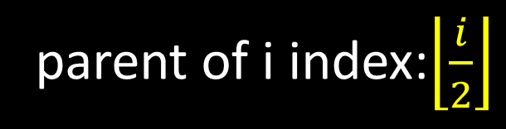
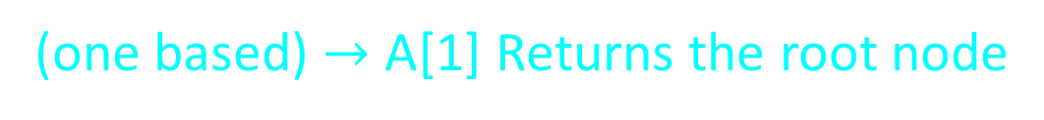
Binary Heap Representation
value
9 | 8 | 7 | 6 | 5 | 1 | 2 | 2 | 2 | 3 | 4 | 0 | 1 | 2 | 1
1 | 3 | 3 | 4 | 5 | 6 | 7 | 8 | 9 | 10 | 11 | 12 | 13 | 14 | 15
index
Let i be a node index
גישה נוספת (נוחות)
9
(one based) $→$ A[1] Returns the root node
8
7
Left child index: 2i
6
5
1
2
Right child index: 2i + 1
parent of i index:$\left\lfloor \frac{i}{2}\right\rfloor$
2
2
3
4
0
1
2
1
Notes:
One last thing before we get into how to add values to our binary heap, I promise.
We need to understand how do we represent and construct one of these binary heaps.
Well, one of the most popular ways to represent a heap is by using an array because
of the complete tree property we talked about. This is however not the only way to
represent a heap we could also use objects and pointers and recursively add and
remove nodes as needed, but right now we’re going to look at the array based construction.
On the left is the index tree to help you visualize the position of each node in the array, and
on the right is the actual tree. Remark that as you read elements in the array from left to right
it’s as though you’re pacing through the heap one layer at a time from left to right.

Slide 8
https://www.cs.usfca.edu/~galles/visualization/Heap.html
private void SwapUp(int index)
public void Heapify(int i)
public void build_heap(int[] A)
public void heapsort(int[] A)
// Traverse up and fix violated property
// A recursive function to max heapify the given
// subtree. This function assumes that the left and
// right subtrees are already heapified, we only need
// to fix the root.
// Function to build a Max-Heap from the given array
// Function to sort a given array

Slide 9
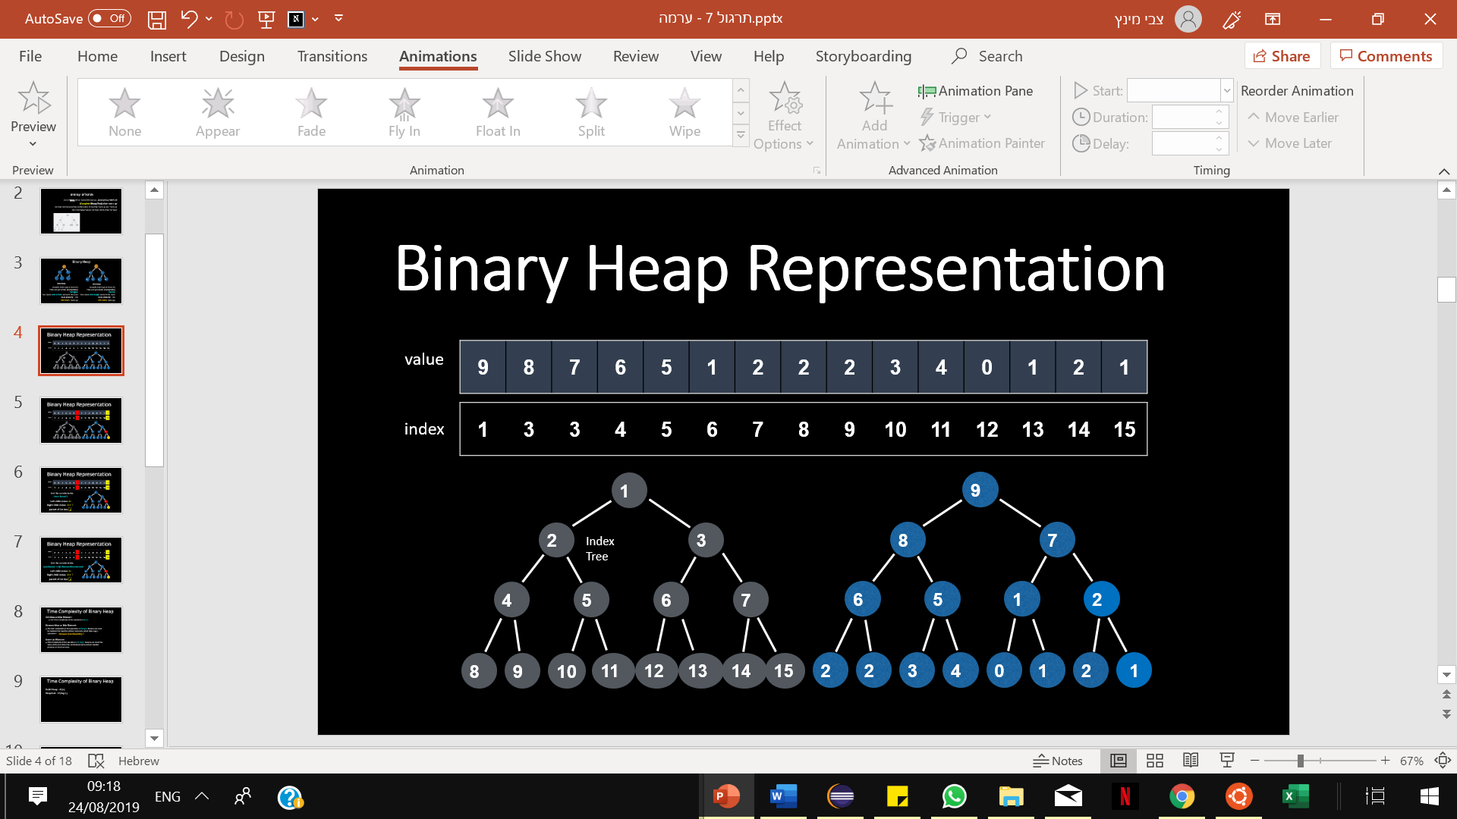
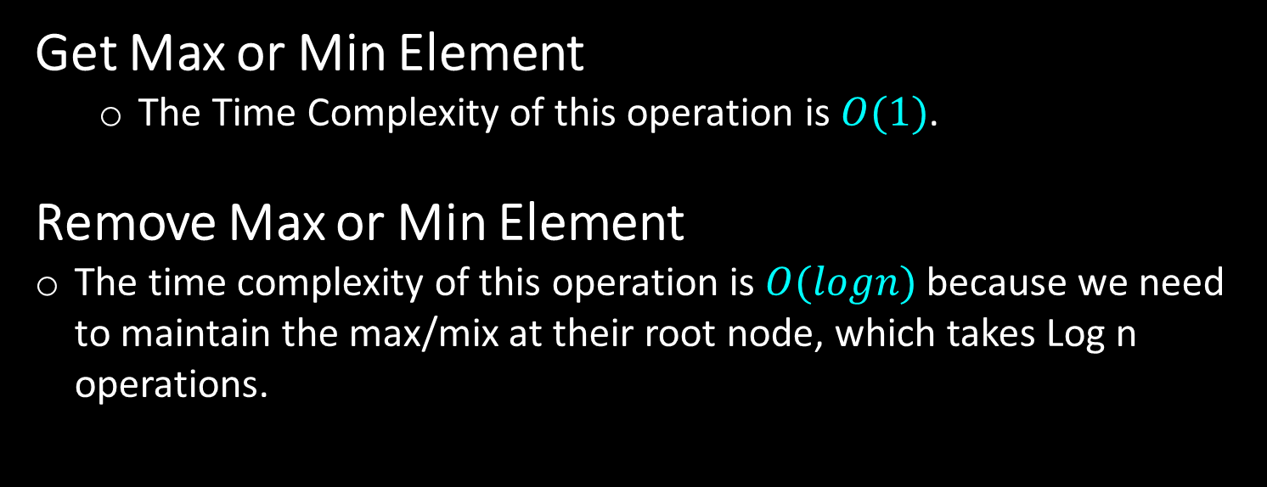
Time Complexity of Binary Heap
Get Max or Min Element
  The Time Complexity of this operation is $O(1)$.
Remove Max or Min Element
The time complexity of this operation is $O(logn)$ because we need to maintain the max/mix at their root node, which takes Log n operations.
Remove (Not Max/Min) ?
Notes:
One last thing before we get into how to add values to our binary heap, I promise.
We need to understand how do we represent and construct one of these binary heaps.
Well, one of the most popular ways to represent a heap is by using an array because
of the complete tree property we talked about. This is however not the only way to
represent a heap we could also use objects and pointers and recursively add and
remove nodes as needed, but right now we’re going to look at the array based construction.
On the left is the index tree to help you visualize the position of each node in the array, and
on the right is the actual tree. Remark that as you read elements in the array from left to right
it’s as though you’re pacing through the heap one layer at a time from left to right.

Slide 10
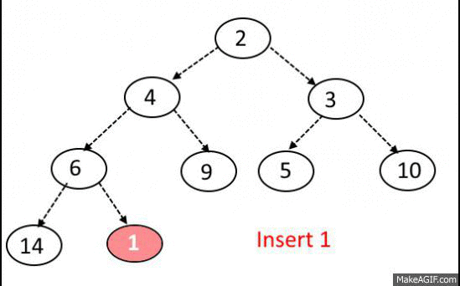
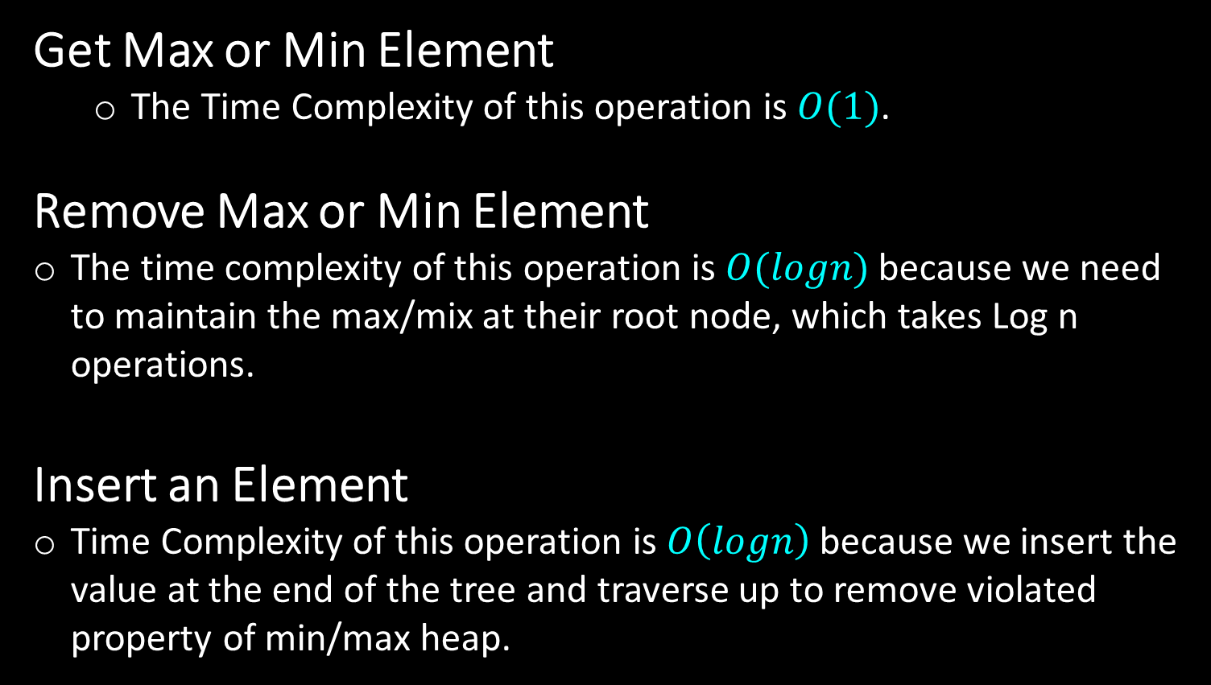
Time Complexity of Binary Heap
Get Max or Min Element
  The Time Complexity of this operation is $O(1)$.
Remove Max or Min Element
The time complexity of this operation is $O(logn)$ because we need to maintain the max/mix at their root node, which takes Log n operations.
Insert an Element
Time Complexity of this operation is $O\left(logn\right)$because we insert the value at the end of the tree and traverse up to remove violated property of min/max heap.
Remove (Not Max/Min) ?
Notes:
One last thing before we get into how to add values to our binary heap, I promise.
We need to understand how do we represent and construct one of these binary heaps.
Well, one of the most popular ways to represent a heap is by using an array because
of the complete tree property we talked about. This is however not the only way to
represent a heap we could also use objects and pointers and recursively add and
remove nodes as needed, but right now we’re going to look at the array based construction.
On the left is the index tree to help you visualize the position of each node in the array, and
on the right is the actual tree. Remark that as you read elements in the array from left to right
it’s as though you’re pacing through the heap one layer at a time from left to right.

Slide 11
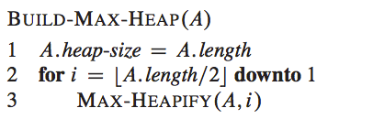
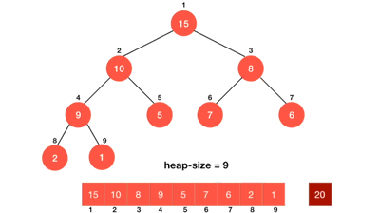
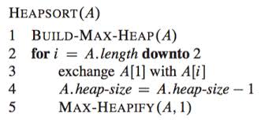

Time Complexity of Binary Heap
one based
Build Heap - $O(n)$
HeapSort - $O(\operatorname{nlog}{n)}$
HeapSort.java
one based
Notes:
One last thing before we get into how to add values to our binary heap, I promise.
We need to understand how do we represent and construct one of these binary heaps.
Well, one of the most popular ways to represent a heap is by using an array because
of the complete tree property we talked about. This is however not the only way to
represent a heap we could also use objects and pointers and recursively add and
remove nodes as needed, but right now we’re going to look at the array based construction.
On the left is the index tree to help you visualize the position of each node in the array, and
on the right is the actual tree. Remark that as you read elements in the array from left to right
it’s as though you’re pacing through the heap one layer at a time from left to right.

Slide 12
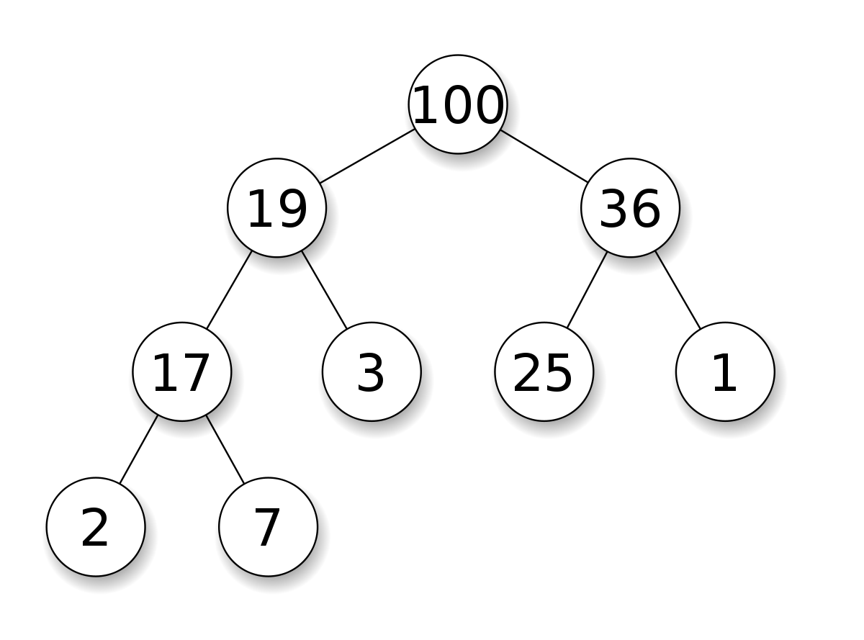
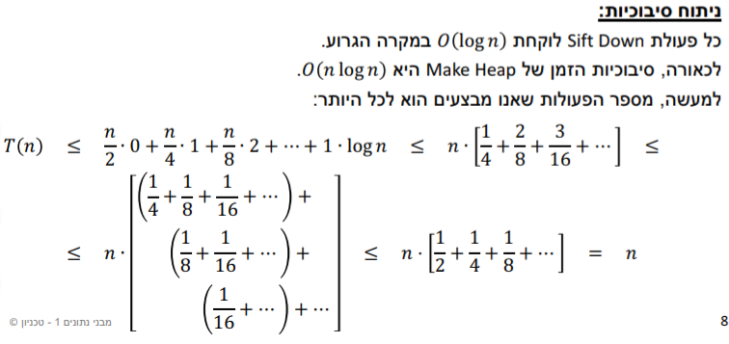
public void build_heap(int[] A) // O(n)

Slide 13
public void build_heap(int[] A) // O(n)
תרגיל בית
one based

Slide 14

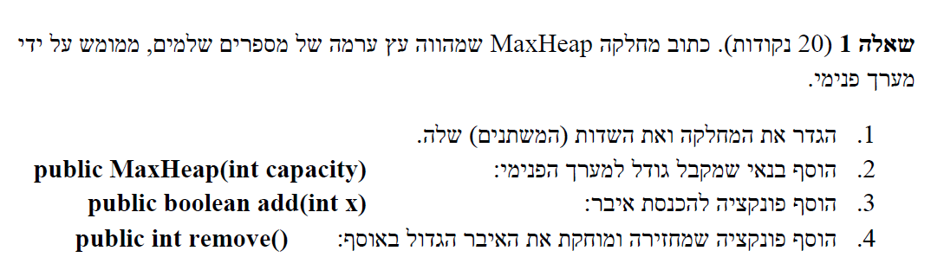
מימושMaxHeap.java
public class MaxHeap
{
…
}
עבודה עצמית (One Based) (20 דקות)
צבי מינץ

Slide 15
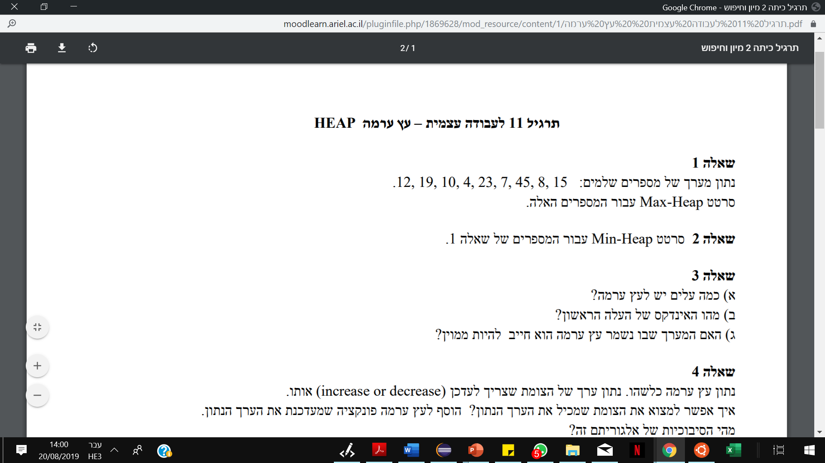
Max Heap
http://btv.melezinek.cz/binary-heap.html
Min Heap
https://www.cs.usfca.edu/~galles/visualization/Heap.html
צבי מינץ – zvimints@gmail.com

Slide 16

מאינדקס 1
$$\left\lceil \frac{n}{2}\right\rceil$$
צבי מינץ – zvimints@gmail.com

Slide 17
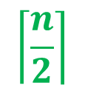
מאינדקס 0
$$\left\lceil \frac{n}{2}\right\rceil$$
צבי מינץ – zvimints@gmail.com

Slide 18
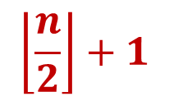
מאינדקס 1
$$\left\lceil \frac{n}{2}\right\rceil$$
$$\left\lfloor \frac{n}{2}\right\rfloor +1$$
צבי מינץ – zvimints@gmail.com

Slide 19
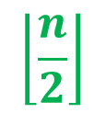
מאינדקס 0
$$\left\lceil \frac{n}{2}\right\rceil$$
$$\left\lfloor \frac{n}{2}\right\rfloor$$
צבי מינץ – zvimints@gmail.com

Slide 20
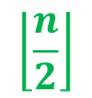
מאינדקס 0
$$\left\lceil \frac{n}{2}\right\rceil$$
$$\left\lfloor \frac{n}{2}\right\rfloor$$
צבי מינץ – zvimints@gmail.com

Slide 21
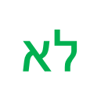
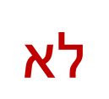
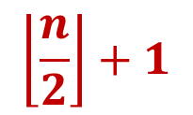

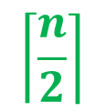
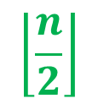
מאינדקס 1
מאינדקס 0
$$\left\lceil \frac{n}{2}\right\rceil$$
$$\left\lceil \frac{n}{2}\right\rceil$$
$$\left\lfloor \frac{n}{2}\right\rfloor$$
$$\left\lfloor \frac{n}{2}\right\rfloor +1$$
$$לא$$
$$לא$$
צבי מינץ – zvimints@gmail.com

Slide 22
בהינתן ערימת מקסימום H,
מה סיבוכיות הזמן למציאת 3 האיברים הגדולים בH?
רעיונות?

Slide 23
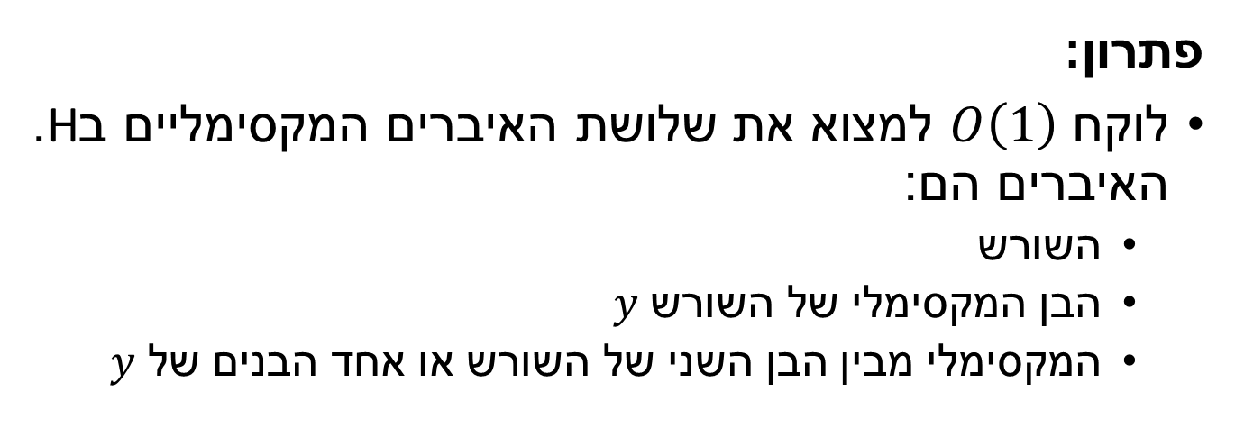
פתרון:
לוקח $O\left(1\right)$ למצוא את שלושת האיברים המקסימליים בH.
האיברים הם:
  השורש
  הבן המקסימלי של השורש $y$
  המקסימלי מבין הבן השני של השורש או אחד הבנים של $y$

Slide 24
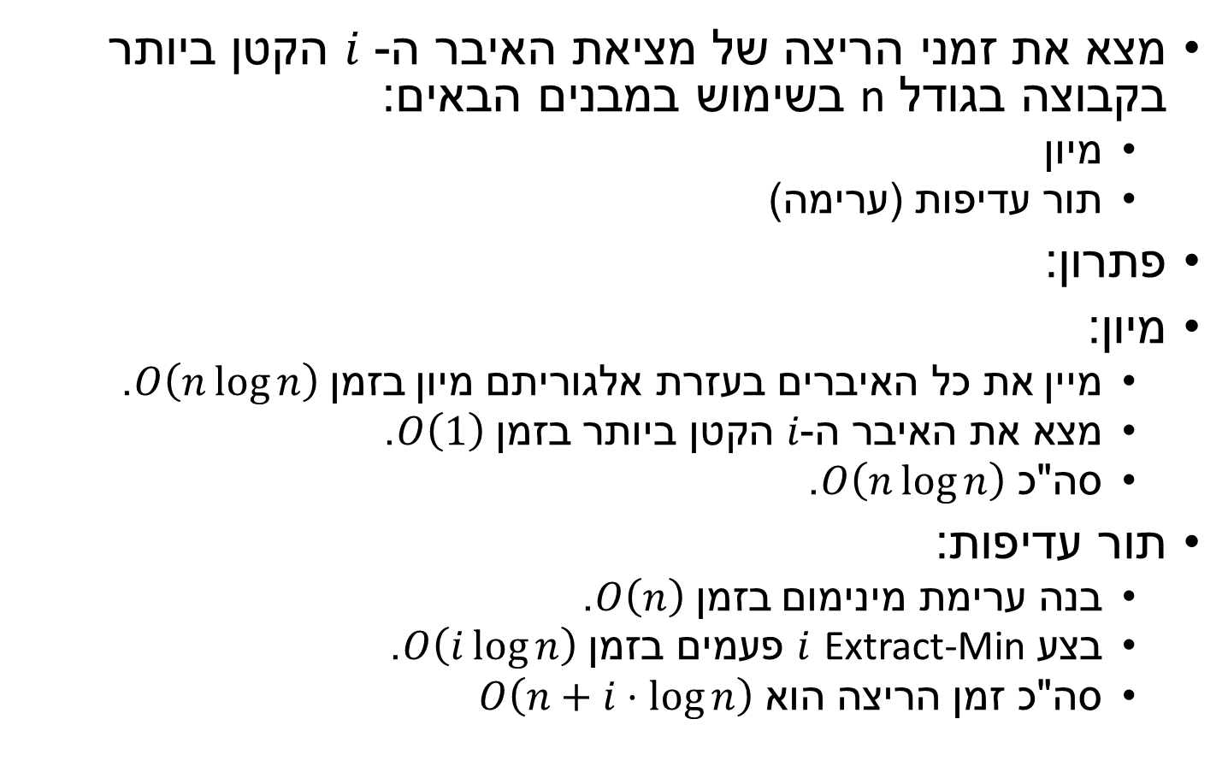
מצא את זמני הריצה של מציאת האיבר ה- $i$ הקטן ביותר בקבוצה בגודל n בשימוש במבנים הבאים:
  מיון
  תור עדיפות (ערימה)
פתרון:
מיון:
  מיין את כל האיברים בעזרת אלגוריתם מיון בזמן $O\left(n\log{n}\right)$.
  מצא את האיבר ה-$i$ הקטן ביותר בזמן $O\left(1\right)$.
  סה"כ $O\left(n\log{n}\right)$.
תור עדיפות:
  בנה ערימת מינימום בזמן $O\left(n\right)$.
  בצע Extract-Min $i$ פעמים בזמן $O\left(i\log{n}\right)$.
  סה"כ זמן הריצה הוא $O\left(n+i⋅\log{n}\right)$

Slide 25
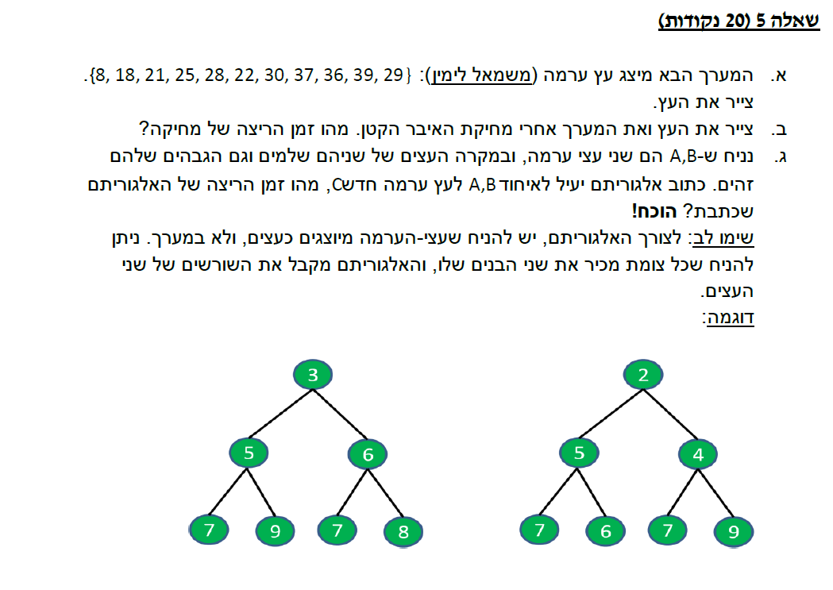
תרגיל בית
תרגיל בית
Array Based
עבודה עצמית
צבי מינץ – zvimints@gmail.com

Slide 26
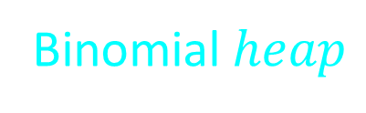
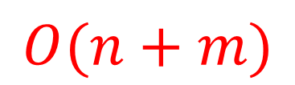
// Merges max heaps a[] and b[] into arr[]
public static void mergeHeaps(int[] arr, int[] a,
int[] b, int n, int m) {
for (int i = 0; i < n; i++) {
arr[i] = a[i];
{
for (int i = 0; i < m; i++) {
arr[n + i] = b[i];
{
n = n + m;
// Builds a max heap of given arr[0…n-1]
for (int i = n/2-1 ; i >= 0; i--) {
maxHeapify(arr, n, i);
  {
{
BASE 0!!
$$O(n+m)$$
Binomial$heap$
צבי מינץ – zvimints@gmail.com

Slide 27
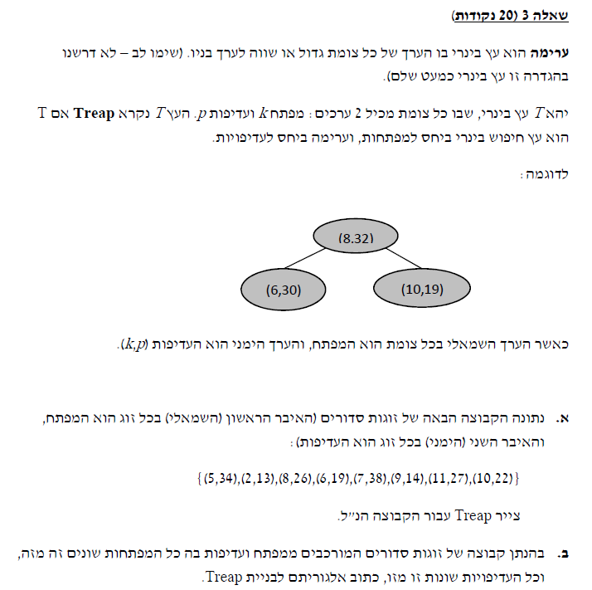
(2,13), (9,14), (6,19), (10,22),
(8,26), (11,27), (5,34), (7,38)
(7,38)
(5,34)
(11,27)
(2,13)
(8,26)
(6,19)
(10,22)
(9,14)
Sort the nodes based on p.
Start picking the node with the largest p
and decide whether it should go to the left subtree
or right subtree based on k.
צבי מינץ – zvimints@gmail.com
https://leetcode.com/discuss/interview-question/363945/google-treap

Slide 28
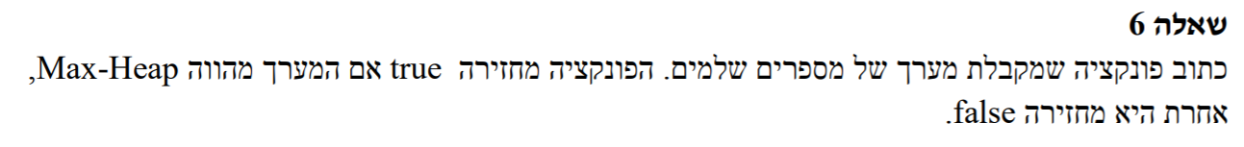
עבודה עצמית
// Function to check if given array represents Min-Heap or not
public static boolean checkMinHeap(int[] A, int i) {
// if i is a leaf node, return true as every leaf node is a heap
if (2*i + 1 >= A.length) return true;
// if i is an internal node
// recursively check if left child is heap
boolean left = (A[i] >= A[2*i + 1]) && checkMinHeap(A, 2*i + 1);
// recursively check if right child is heap (to avoid array out
// of bound, we first check if right child exists or not)
boolean right = (2*i + 2 == A.length) ||
(A[i] >= A[2*i + 2] && checkMinHeap(A, 2*i + 2));
// return true if both left and right
// child are heap
return left && right;
}
public static void main(String[] args) {
}
int[] A = {6,5,4,3,2,1,0};
// start with index 0 (root of the heap)
int index = 0;
System.out.println(checkMinHeap(A, index) ? "YES" : "NO");
צבי מינץ – zvimints@gmail.com

Slide 29
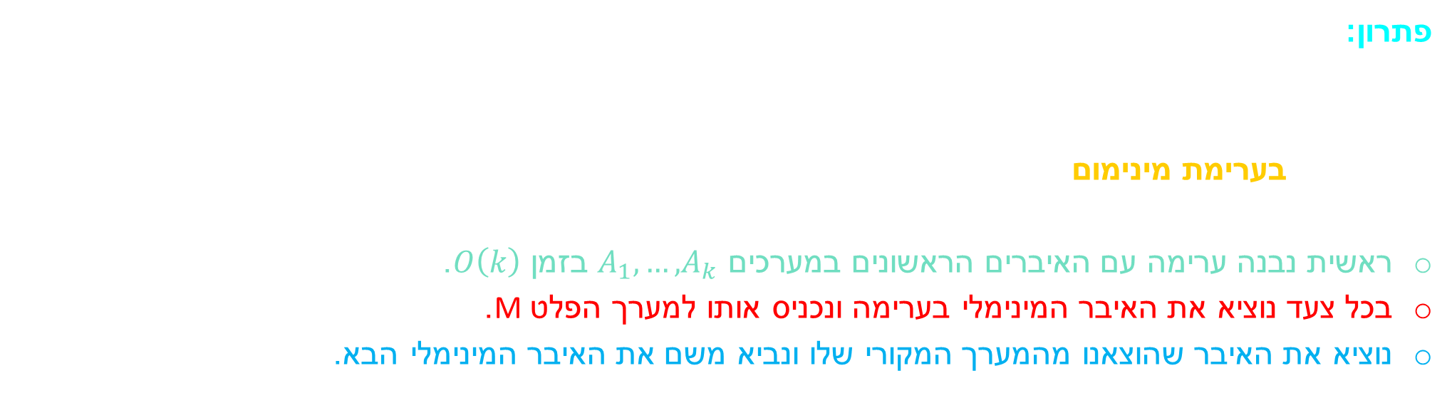
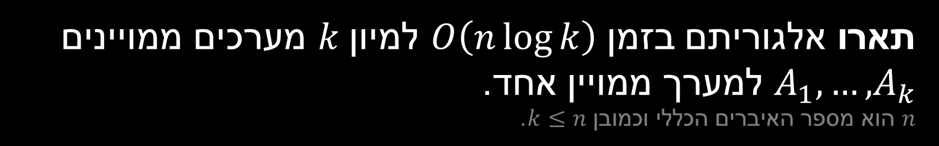
תארו אלגוריתם בזמן $O\left(n\log{k}\right)$ למיון $k$ מערכים ממויינים $A_{1},…,A_{k}$ למערך ממויין אחד.
$n$ הוא מספר האיברים הכללי וכמובן $k≤n$.
פתרון:
נבנה ערימה שתשמור בכל שלב את האיברים החשודים להיות האיבר הקטן הבא.
כלומר, נרצה לשמור את האיבר הראשון בכל אחד מהמערכים $A_{1},…,A_{k}$.
נשתמש בערימת מינימום אשר כל איבר בה הוא שלשה מהצורה $(d, i, A_{d}\left[i\right])$
כאשר $d∈[1,k], i∈\left[1,n\right]$, הערימה תיוצג ע"י המערך B.
ראשית נבנה ערימה עם האיברים הראשונים במערכים $A_{1},…,A_{k}$ בזמן $O\left(k\right)$.
בכל צעד נוציא את האיבר המינימלי בערימה ונכניס אותו למערך הפלט M.
נוציא את האיבר שהוצאנו מהמערך המקורי שלו ונביא משם את האיבר המינימלי הבא.
d – איזה רשימה
i – איזה איבר ברשימה
for d←1 to k
  B[d] ← (d, 1, A_{d}[1])
Build-Heap(B) /*By the order of A_{d} [1] */
for j=1 to n
  (d, i, x) ← Extract-Min(B)
  M[j]←x
  if i < A_{d}.length then Heap-Insert(B,(d, i+1, A_{d}[i+1]))
Worst case time analysis:
  Build-Heap : O(k) – done 1 time
  Extract-Min : O(log k) – done n times
  Heap-Insert : O(log k) – done n times
  Total: O(nlogk)
צבי מינץ – zvimints@gmail.com

